Slide 1


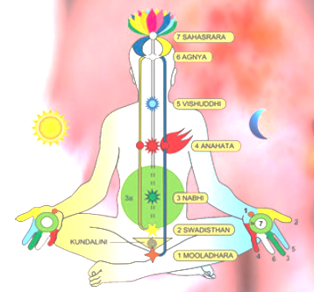
Introducing
Sahaja Yoga
The Final Destination

Slide 2
Topics to Cover
Types of Yoga
Historical references of Kundalini Shakti/ Kundalini Yoga/ Serpent Energy
About Shri Mataji Nirmala Devi, Founder – Sahaja Yoga
About Sahaja Yoga Meditation
Our Subtle System – Chakras, Nadis and their respective qualities
Scientific experimentation & evidences on the effects of SYM in Medical Science

Slide 3
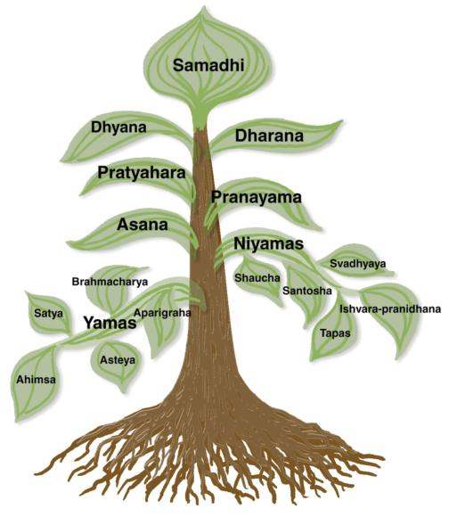
TYPES OF YOGA
Four primary types of yoga: karma, bhakti, jnana, and raja.
Karma yoga is the path of service through selfless action for the good of others - for example, many yoga teacher training programs require candidates to practice karma yoga by cooking and cleaning or providing other voluntary service for others.
Bhakti yoga cultivates the expression and love of the Divine through devotional rituals. Forms of this path include regular prayer, chanting, singing, dancing, ceremony, and celebration.
Jnana yoga is the path of intellect and wisdom, and its components include study of sacred texts, intellectual debates, philosophical discussion, and introspection. Eg. Socrates was a jnana yogi.
Raja yoga, also known as the "royal path," refers to the journey toward personal enlightenment. This path consists of balancing the three main yoga types just described - karma, bhakti, and jnana - while integrating the eight limbs, or stages, of yoga. Hatha yoga is represented as a combination of the third and fourth limbs of the royal path - that is, asana and pranayama.

Slide 4
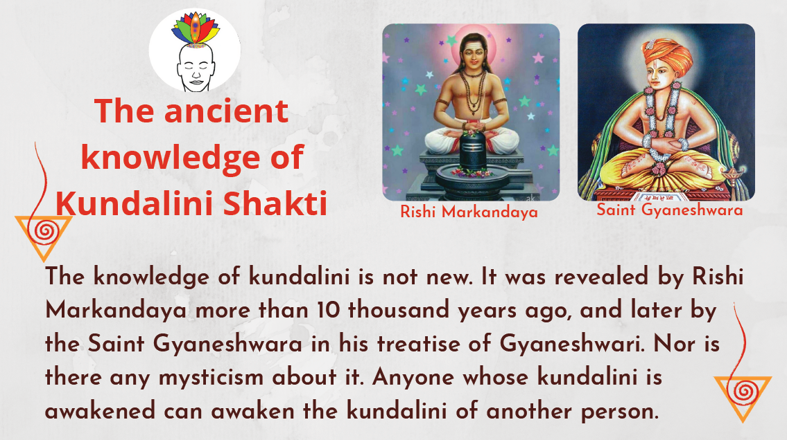

Slide 5
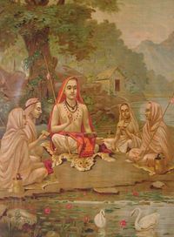
Kundalini Energy – Historical References
Adi Shankaracharya
He lived in the 7th-8th century AD. was an Indian mystic, also known as Sankara, whose writings include Vivekachudamani and Saundarya Lahari, a praise of the Mother Goddess. He wrote:
“Having filled the pathway of the Nadis with the streaming shower of nectar flowing from the Lotus feet, having resumed thine own position from out of the resplendent Lunar regions and Thyself assuming the form of a serpent of three and a half coils, sleepest thou, in the hollow of Kula Kunda (Kula Kunda means the hollow of Mooladhara Sacrum bone).”
“Saundarya Lahari: "Thou art residing in secrecy with Thy Lord (The spirit) in the thousand petalled Lotus, having pierced through the Earth situated in 'Mooladhara', the Water in Manipura, the Fire abiding in the Svadhisthana, the Air in the Heart ('Anahata'), the Ether above (Visshuddhi) and 'Manas' between the eyebrows ('Agnya') and thus broken through the entire 'Kula Path'.”
Shri Mataji Nirmala Devi:
The Kundalini awakening is very clearly described by Adi Shankaracharya. He has said it in one of his couplets, “Na yoga, na sankhya.” By all these tricks and by reading about Kundalini, the Kundalini does not rise. Only through the Mother’s grace, it will rise. (1980-05-01)
Adi Shankaracharya was asked, “Which is the greatest quality?” He said, “Devi bhakti, Mother’s bhakti.”

Slide 6
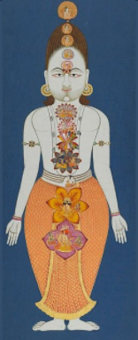
Kundalini Energy – Historical References
“The word Kundalini is derived from a Sanskrit word Kundal meaning coiled up. It is the primordial dormant energy present in three-and-a-half, coils at the base of the spine in a triangular bone called the Sacrum. The Latin name Os Sacrum suggests that it is a holy or sacred part of the body. The ancient Greeks were aware of this and therefore they called it the Hieron Osteon, noting that it was the last bone to be destroyed when the body is burnt, and also attributed supernatural powers to it.
The name chakra was found in the oldest text called the Vedas. The chakras as psychic centers of consciousness are first mentioned in the Yoga Upanishads (600 B.C.) and later in the Yoga Sutras of Patanjali (200 B.C.).
Kundalini Yoga is supposed to be supreme in all the Yogas. Guru Vashistha asserted that Kundalini is the seat of absolute knowledge. The awareness of the presence of this primordial energy Kundalini within the human body was considered by the sages and saints to be the highest knowledge. The Kundalini and Chakras have been vividly described in Vedic and Tantric texts.

Slide 7
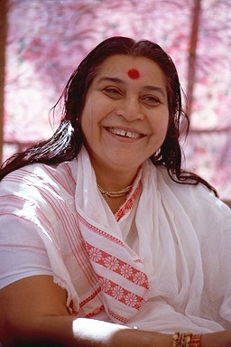
Shri Mataji Nirmala Devi
Her Holiness Shri Mataji Nirmala Devi, (21 March 1923 – 23 February 2011) is a renowned spiritual guru and founder of Sahaja Yoga/ Vishwa Nirmala Dharma.
Her parents Shri P. K. Salve and Smt. Cornelia Salve were direct descendants of the royal Shalivahana dynasty and played a key role in India's Independence movement. Her father, a close associate of Mahatma Gandhi, was the member of the Constituent Assembly of India and helped write Independent India's first constitution. He was a renowned scholar, master of 14 languages, and translated the Quran in Marathi.
Her mother was the first woman in India to receive an Honors Degree in Mathematics. Shri Mataji herself was an active participant in the Indian Freedom Movement. She spent a lot of her time in the Ashram of Mahatma Gandhi.

Slide 8

The Discovery of Sahaja Yoga
Her Holiness Shri Mataji Nirmala Devi discovered this process of Kundalini Awakening called Self-Realization on 5th May 1970 and has since given Self-Realization to seekers all around the world.
The Kundalini Awakening through Sahaja Yoga Meditation changed the lives of millions of people all over the world as she traveled across continents to ensure seekers all over the world get their Self-Realization. Sahaja Yoga started with H.H. Shri Mataji Nirmala Devi spending Her own money and by selling Her precious jewelry and dedicated Herself for the evolution of mankind. It was Her perseverance and dedication to the cause of evolution of mankind that today Her disciples are in almost every large city across all major countries.
She believed that the kundalini power once awakened within the seeker has the potential to resolve all physical, mental, emotional and spiritual issues. Seekers who received their Self-Realization felt the cool breeze (vibrations) on their palm and above the head thus scientifically feeling the Kundalini movement within the seeker.

Slide 9
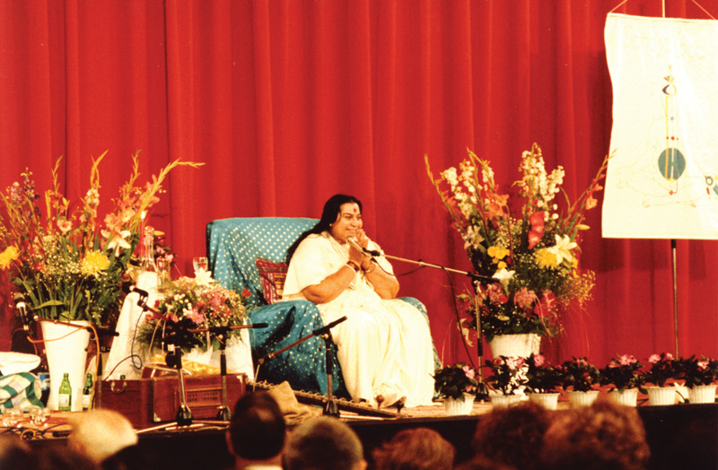
Recognizing Her Work
Shri Mataji's humanitarian and spiritual work draws admiration not only from countless individuals in more than 95 nations who have personally benefited from her teachings, but also from governments, dignitaries, educational institutions and humanitarian organizations.
Recognizing the scientific and verifiable nature of her teachings, the Petrovskaya Academy of Arts and Sciences in St. Petersburg bestowed an Honorary Membership upon Shri Mataji, telling her, “You are even higher than science.”
Others, such as Claes Nobel, thanked her for giving hope to humanity. She accepted all awards with characteristic humility, praising the efforts of others and insisting on collective, rather than individual, achievement.
Despite relentless travelling, Shri Mataji never referred to her demanding schedule as tiresome, equating it rather with the work of a loving mother looking after her children’s wellbeing.
“A MOTHER’S POSITION IS DIFFERENT, THIS PATIENCE AND THIS LOVE AND THIS FORGIVENESS IS INNATELY BUILT IN A MOTHER … HER ATTITUDE IS VERY DIFFERENT. NOT ANY ACHIEVEMENT, NOT ANY BIG NAME OR A SORT OF AN AWARD OR ANYTHING … SHE DOES IT BECAUSE SHE IS A MOTHER.

Slide 10
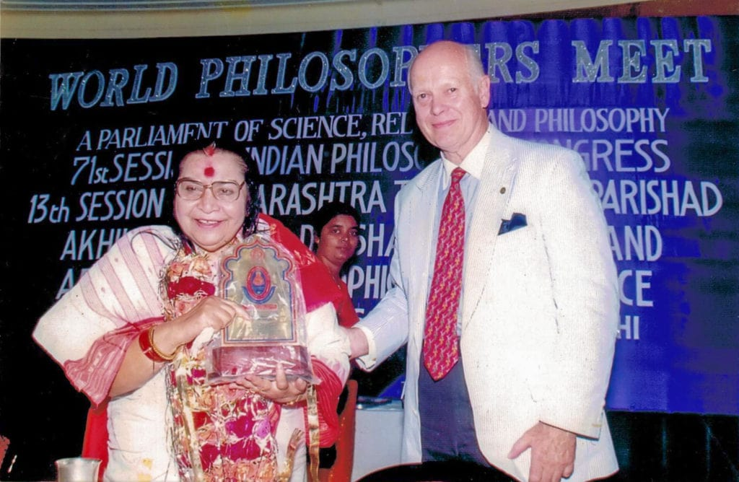

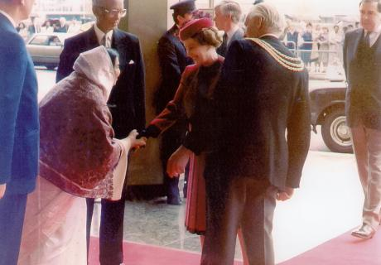

Shri Mataji - Awards and Recognitions
Shri Mataji with Claes Nobel, Pune (India)
Shri Mataji at the UN Conference (China, 1995)
Shri Mataji shaking the Queen's hand in London, UK
Petrovskaya Academy conferred on Shri Mataji the Honorary Membership - St. Petersburg, Russia, 1993
A Selection of Awards and Recognitions
Shri Mataji has been recognized worldwide by several prestigious institutions for her selfless work and for the remarkable results of her spiritual teachings through Sahaja Yoga, a few of which are listed below.
Italy, 1986
Declared ‘Personality of the Year’ by the Italian Government.
Moscow, Russia, 1989
Following Shri Mataji’s meeting with the USSR Minister of Health, Sahaja Yoga was granted full government sponsorship, including funding for scientific research.
New York, 1990-1994
Invited by the United Nations for four consecutive years to speak about the ways and means to achieve world peace.
St. Petersburg, Russia, 1993
Appointed as Honorary Member of the Petrovskaya Academy of Art and Science. In the history of the Academy, only twelve people have been granted this honour, Einstein being one of them. Shri Mataji inaugurated the first International Conference on Medicine and Self-Knowledge, which became an annual event at the Academy thereafter

Slide 11
Shri Mataji - Awards and Recognitions
Brazil, 1994
The mayor of Brazilia welcomed Shri Mataji at the airport, presented her with the key to the city and sponsored all of her programs.
New York, 1994
September 26 proclaimed ‘Shri Mataji Nirmala Devi Day.’ Police escort was offered for a welcoming parade honouring Shri Mataji and celebrating her association with Mahatma Gandhi.
British Columbia, Canada, 1994
Letter of welcome was proffered by the Premier of the Province of British Columbia, Mr. Mike Harcourt, on behalf of the people of Canada.
Romania 1995
Awarded Honorary Doctorate in Cognitive Science by Prof D. Drimer, head of the Ecological University Bucharest.
China, 1995
Official guest of the Chinese Government to speak at the United Nations International Women’s Conference.
Pune, India, 1996
On the occasion of the 700th Anniversary of Saint Gyaneshwara, Shri Mataji addressed the 'World Philosophers Meet '96 - A Parliament of Science, Religion and Philosophy,' where she was felicitated for her spiritual movement, Sahaja Yoga.
London, 1997
Mr. Claes Nobel, grandnephew of Alfred Nobel, chairman of United Earth and The National Society of High School Scholars, honoured the life and work of Shri Mataji in a public speech at the Royal Albert Hall.
USA, 105th Congress, 1997 and 106th Congress, 2000
Honorarium read into Congressional Record by Congressman Eliot Engle commending Shri Mataji for her dedicated and tireless work for humanity.
Cabella Ligure, Italy, 2006
Shri Mataji was awarded honorary Italian citizenship, which was followed by the unveiling of the foundation stone for the 'Shri Mataji Nirmala Devi World Foundation of Sahaja Yoga.' This Foundation has its home in Cabella Ligure.

Slide 12
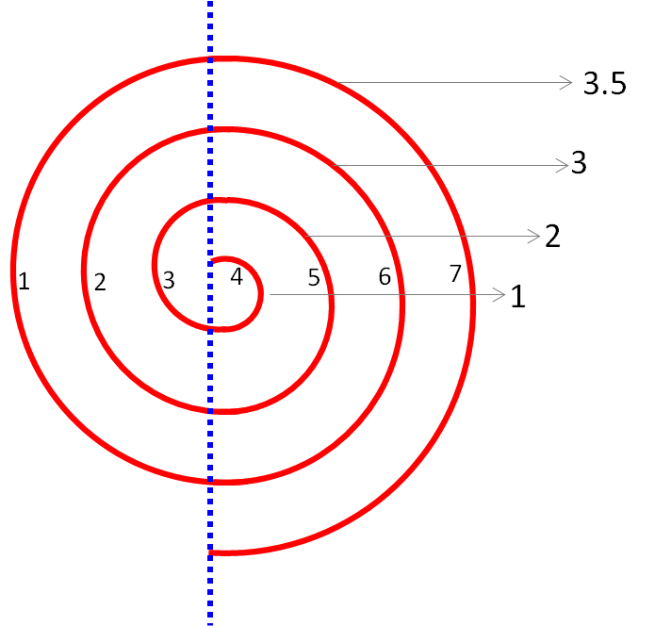
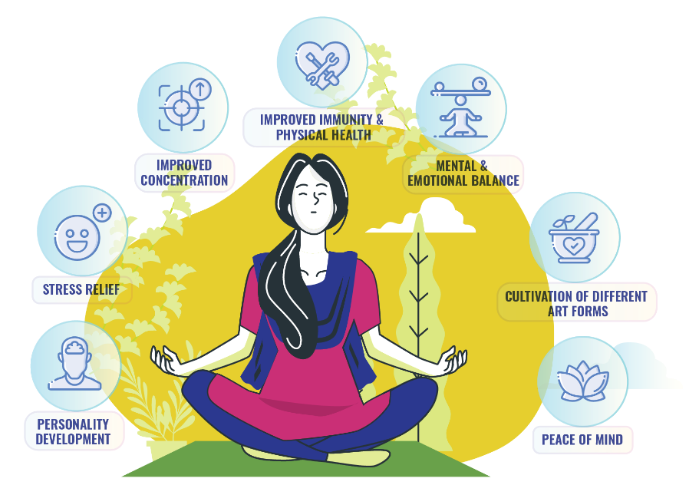
Shri Mataji on Kundalini Shakti
Kundalini is the evolutionary, feminine energy of the divine Mother or the essence of evolution, which nourishes, balances and purifies.
She exists in a latent form in every human being, residing in the sacrum bone in three and a half coils.
When awakened properly, the Kundalini travels upwards through the central channel, subtly and painlessly cleansing and integrating all the chakras, emerging at the apex of the skull and manifesting as a blissful breeze-like sensation on the head and hands.
It is at this point that Self-Realization takes place.
This state is maintained through daily meditation. (Kundala means “coil.”)

Slide 13
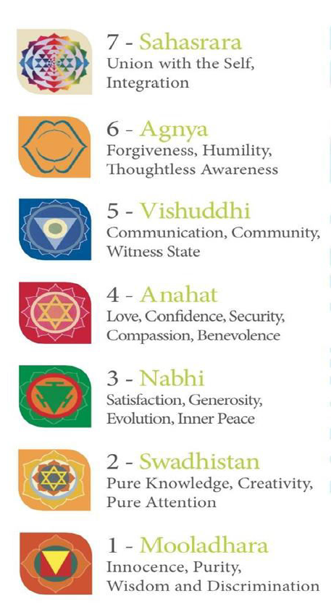
Shri Mataji on Kundalini Shakti
You have to be like a child when you want to have the blessings of Kundalini because She is your mother and She is all the time following you. She is born again and again within you and She is watching you and She is recording all that you have been doing.
***
When the seeking became subtler and subtler, you reached a state where you wanted to seek the power and the money and then your emotional enjoyment. But when it became the subtlest, you started seeking the Spirit because ultimately you have to become the Spirit. It is natural to be animals, but it is also natural to ascend. Ascending towards the Spirit, one finds a big gap. This gap is filled with Kundalini Awakening.
***
This Kundalini is your mother, your individual mother. She knows everything about Me. She has everything recorded in Her inner coils just like a tape recorder. She knows everything and She is very anxious to give you your Realization. She is the reflection of the Primordial Mother, the Holy Ghost. And She is just waiting.
(Shri Mataji Nirmala Devi, 22 February 1977, 15 June 1979, 21 September 1980, 16 September 1983 and 5 October 1993)

Slide 14
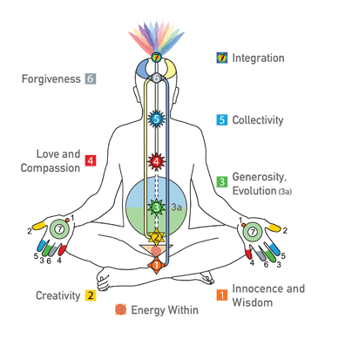
Benefits Of Sahaja Yoga Meditation
We become calm and composed
Stress and tension are reduced
Physical health improves
Sleep is sound and untroubled
Family life and all relationship becomes harmonious
WE are able to get rid of negative emotions like fear, insecurity, hatred, jealousy etc. instantaneously
Bad habit such as smoking, drinking, roving eyes etc drop out automatically
Deep spiritual states can be enjoyed while living the normal life of a house holder
Through Inner Awareness and we are able to guide ourselves
There is a gradual improvement in the value system - ethics, morals - of the person
We develop ‘Vibratory Awareness’ – the ability to feel the state of our subtle body inside.

Slide 15
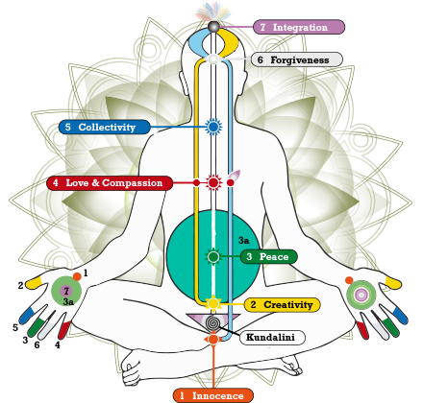
The Subtle System

Slide 16
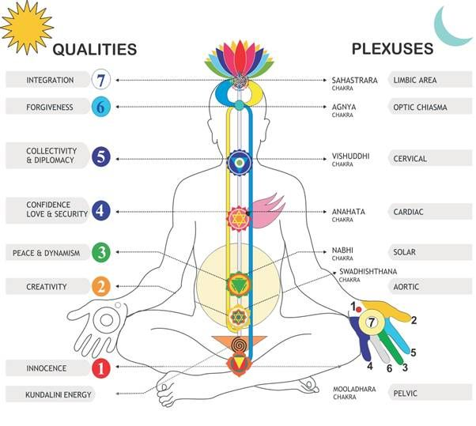
Sahaja Yoga meditation harnesses the power of the inner energy already within you known as the subtle energy, or Kundalini energy. This inner energy system includes a complete system of energy channels and energy centers, or chakras, each of which is associated with specific human characteristics and traits.

Slide 17
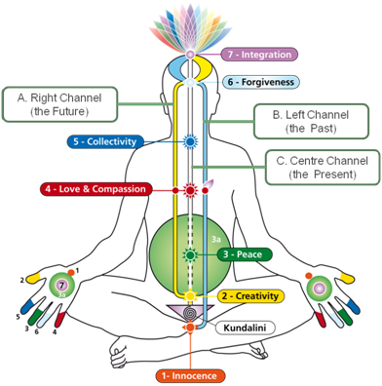
The subtle energy system is comprised of the following key components:
Inner energy (Kundalini) — a vital, living energy that lies dormant in the sacrum bone and can be awakened through meditation.
3 energy channels that correspond to the nervous systems in our body.
7 primary chakras or energy centers that correspond to the main nerve plexuses in the spinal column.
The subtle Inner Self or the Spirit

Slide 18
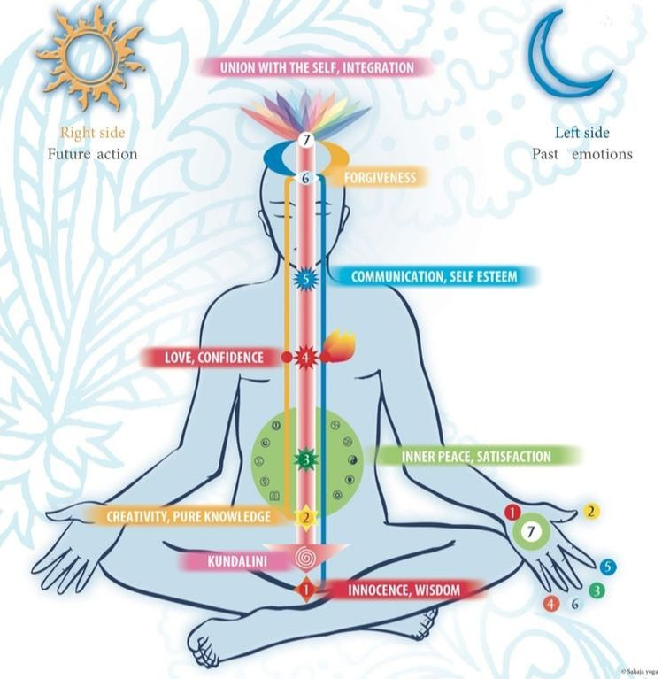


Subtle System
The Kundalini is like the germinating principle in the seed - a reflection of the divine energy in us. The three energy channels represent the past, present and future and capture the history of our being, as well as the physical and mental drivers (right channel) and emotional drivers (left channel).
The energy centers are the accumulators of qualities and traits within us. And the Spirit is our ultimate soul, or root of our existence.
These key energy system components work in synchronicity to drive every aspect of our well-being — cognitive, emotional, physical and spiritual.

Slide 19
The Kundalini Energy
The Kundalini is the primordial energy — the source of all energy.
We’re all born with it and it cannot be destroyed.
It is a living energy that knows how to act. However, it lies dormant within each of us until it is awakened.
Sahaja Yoga meditation techniques have the capacity to awaken this energy.
We’ve known that the Kundalini energy exists for thousands of years. Meditation practitioners in ancient times documented its existence, but the vast majority struggled to explain this subtle energy, to awaken it and reliably raise it so that it actually be used in practical ways to improve their lives.
A the time of our birth, the inner Kundalini energy passes through the brain and creates a vast, intricate system of energy channels and energy centers throughout the central nervous system. Once awakened, this energy flows throughout the body via the 3 main energy channels, or nadis, flowing up through 7 principal energy centers, or chakras.

Slide 20
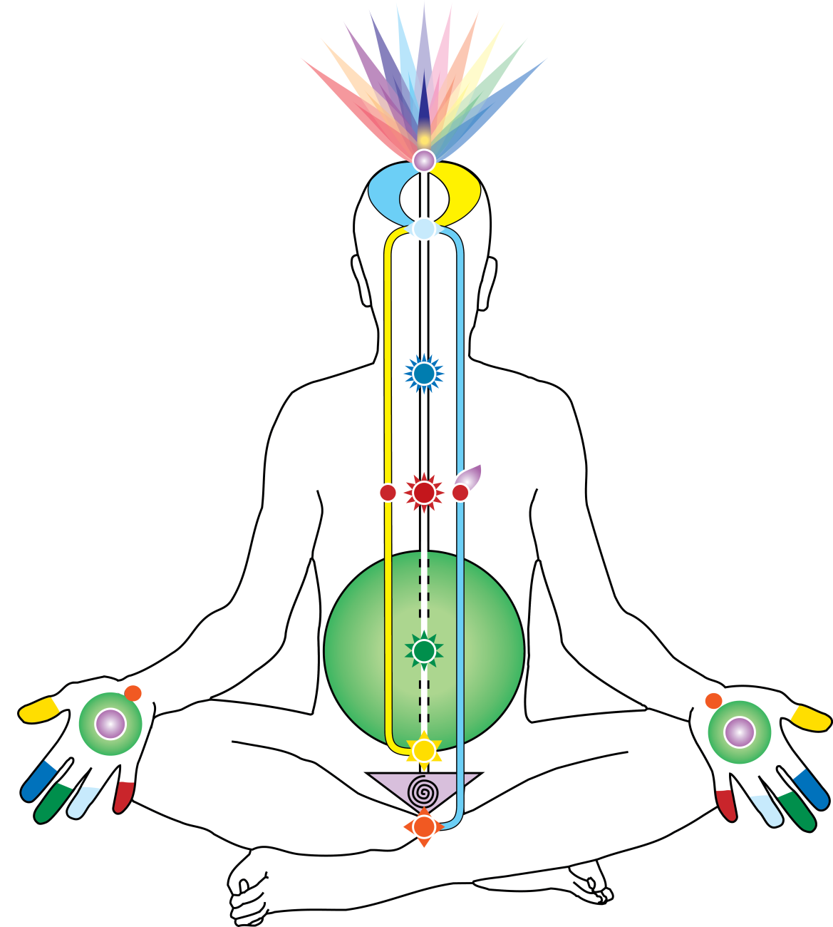
The Subtle Energy Channels
The three channels —
left, center and right — work together in synchronicity to integrate and balance your inner energy (and thus your well-being), but each has a specific role to play.
Ida Nadi
Pingala Nadi
Sushumna
Nadi
The Left Channel (Ida nadi)
The Right Channel (Pingala nadi)
The Central Channel (Sushumna nadi)

Slide 21
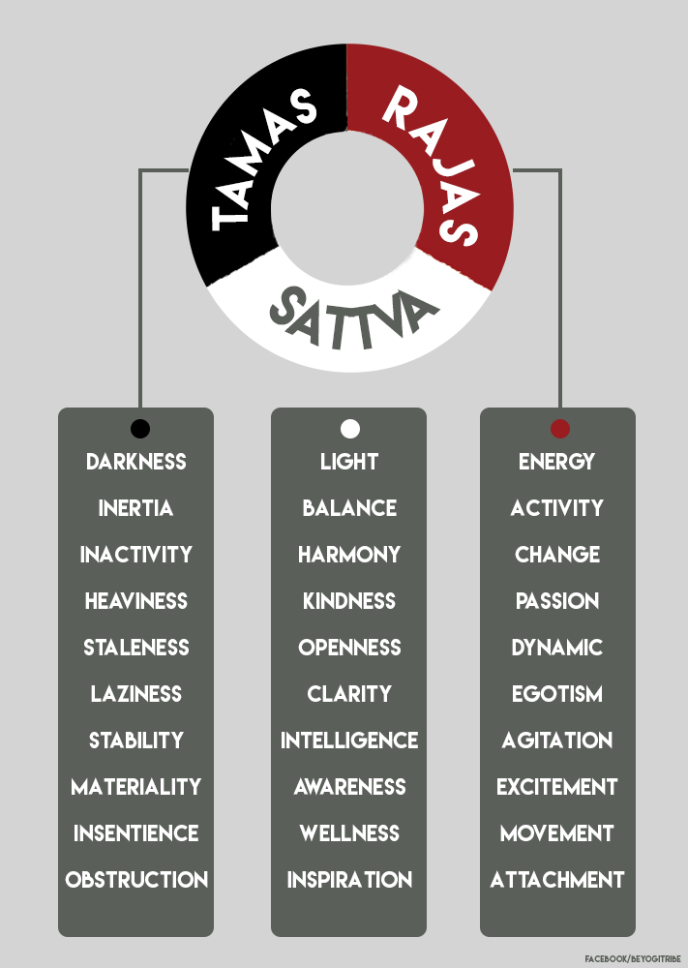
Ayurveda, Three Gunas & Balance
Ida Nadi | Tamas
Pingala Nadi | Rajas
Sushumna Nadi | Sattva

Slide 22
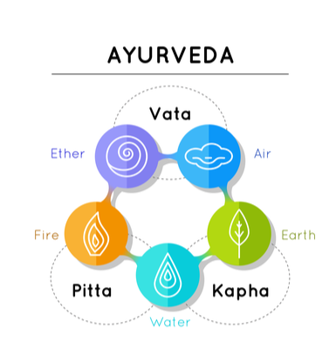
Chakra Elements
Vibrations
Light
Ether
Air
Water
Fire
Earth

Slide 23
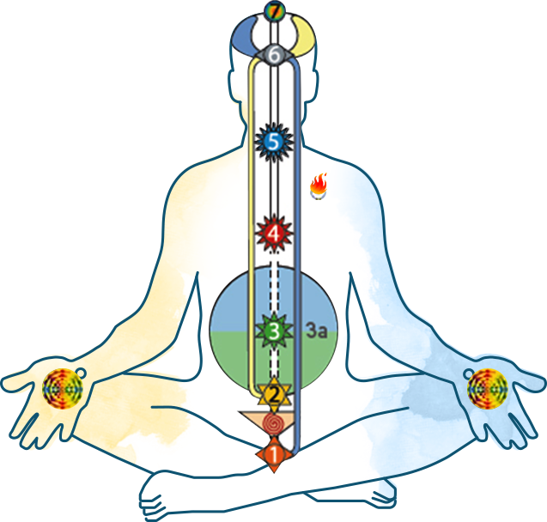
The Left Channel (Ida Nadi)
The Left Channel (Ida Nadi), also known as the Moon Channel, begins at the 1st chakra (Mooladhara) and passes up through the left side of the body, crossing the Agnya Chakra into the temple and terminating on the right side of the brain.
The left channel carries the energy of desire and it corresponds to our past, emotions, desires and our affection for others.
Ida Nadi
Ida Nadi Starts at Mooladhara

Slide 24
The Right Channel (Pingala Nadi)
The Right Channel (Pingala Nadi), also called the Sun Channel, begins at the 2nd chakra (Swadisthan) and travels up the right side of the body.
The right channel is the conduit for the energy of action and planning, which drives our mental and physical activities.
Pingala Nadi
Begins at 2nd Chakra

Slide 25
The Central Channel (Sushumna Nadi)
The Central Channel (Sushumna nadi), also known as the Middle Path, extends from the sacrum bone at the base of the spine (where the Kundalini energy resides) straight up the spine towards the Sahasrara
(the 7th, uppermost chakra).
The central channel is the channel of spiritual ascent, the power which sustains our evolution and guides us, consciously or unconsciously, towards the higher awareness of the Sahasrara.
Sushumna nadi
Sahasrara Chakra

Slide 26
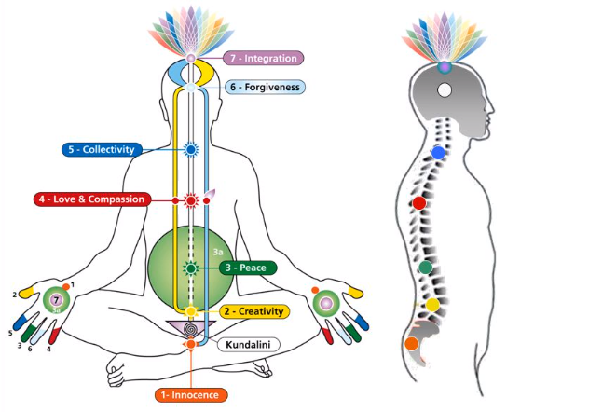
Chakra Arrangement In Subtle System

Slide 27
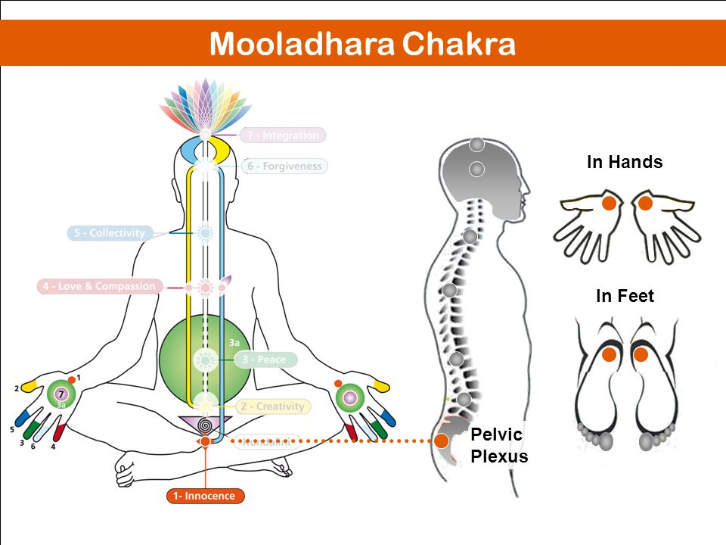
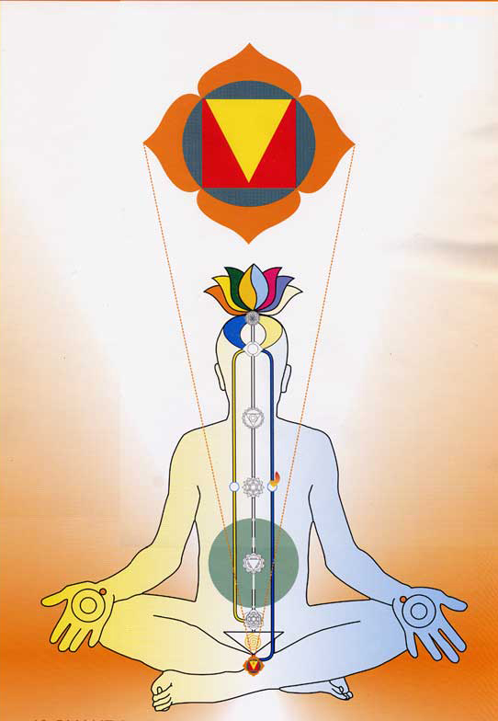

Slide 28

Mooladhara Chakra - Pelvic plexus
First Chakra, situated below the sacrum bone.
Element: Earth / Carbon
Physical Aspect: Prostate gland.
Qualities: Innocence, wisdom, chastity, sense of direction, balance, joy, purity, auspiciousness, simplicity.
Causes of Imbalance: Sexual excessiveness, tantric & occult practices.
In the body the Mooladhara Chakra controls the excretory functions, as well as sexual activity, and exerts a general control on the sympathetic nervous system.

Slide 29
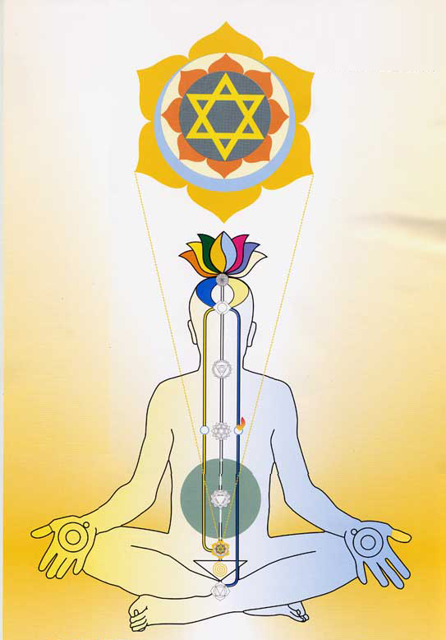
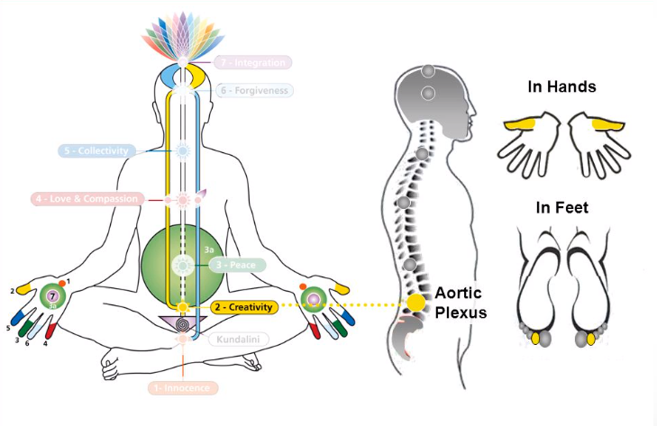
Swadhisthan Chakra

Slide 30
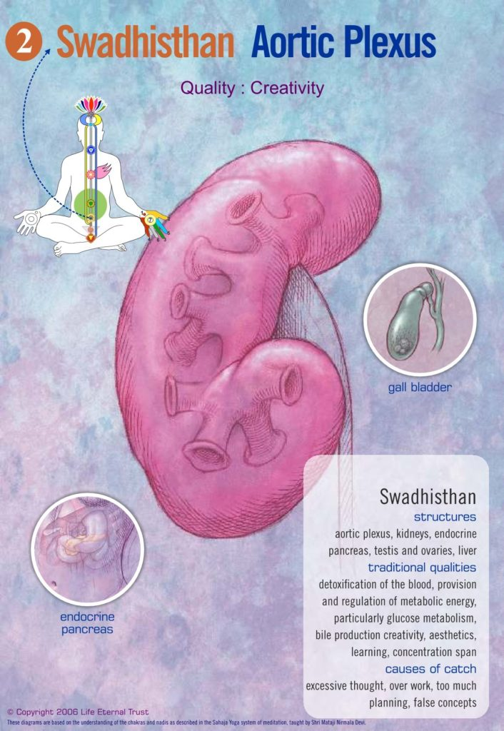
Swadisthana Chakra - Aortic plexus
Element : Fire
Physical Aspect : Kidneys, liver, pancreas, spleen, lower abdomen
Qualities : Creativity, pure attention, pure knowledge, inspiration, power of concentration, aesthetics & arts
Causes of Imbalance :Black magic, false gurus/knowledge, alcohol and drugs (psychedelic drugs), excessive thinking and planning, bad eating habits, ego oriented life, domination
Diseases : Diabetes, blood cancer, kidney troubles
On the physical level this center plays an important role in controlling the abdominal organs such as the liver, kidneys and the large intestines. The reproductive organs of the woman are also partly controlled by this center. It also determines the concentrative power of the attention, its sharpness.

Slide 31
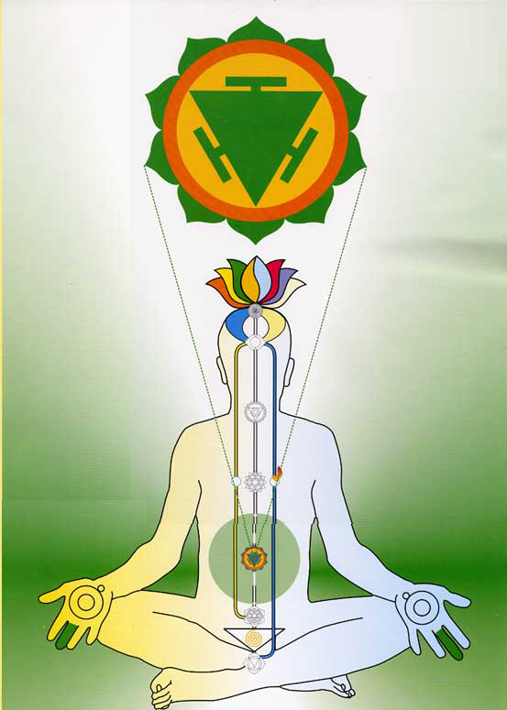
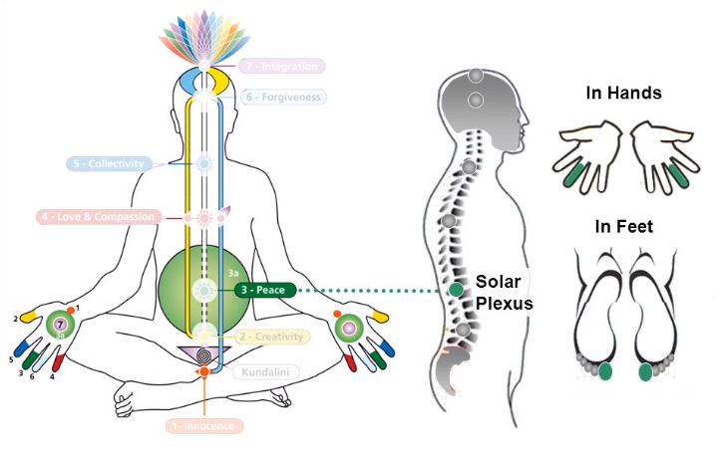
Nabhi Chakra

Slide 32
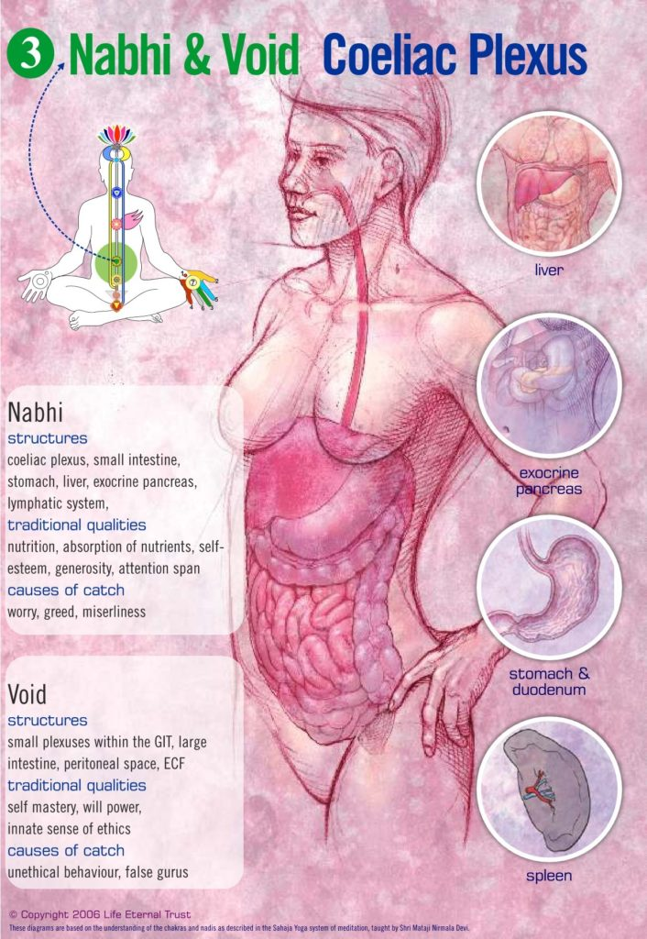
The Nabhi Chakra - Solar Plexus
Element : Water
Physical aspect :Looks after liver, stomach and intestines, spleen and pancreas
Qualities : Sense of generosity, complete satisfaction, peace contentment,, righteousness (Dharma), inner sense of morality, evolution, sense of dignity, good host
Causes of Imbalance : Miserliness, bad eating habits , asceticism, alcohol, drugs, family/ household problems, dominating husband /wife, too much rushing around, worrying
In our body this Chakra controls the stomach, the pancreas and many other organs around the solar plexus. Material satisfaction and a sense of a calm arising from a healthy Nabhi Chakra allows our attention to turn to subtler things.

Slide 33
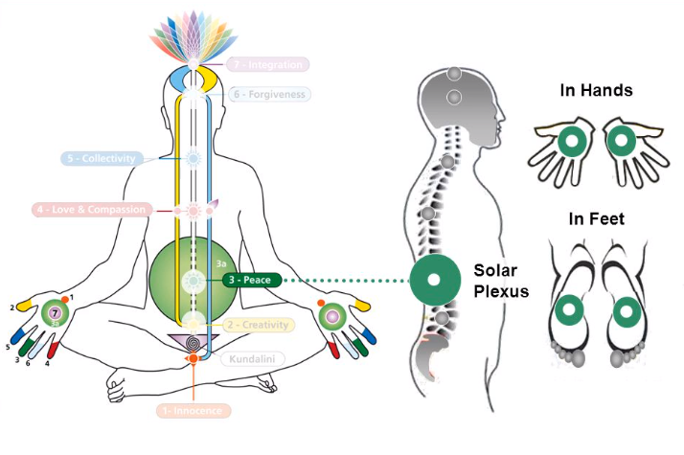
Bhavsagar – The Void

Slide 34
The Void (Bhavsagara) Ocean of Illusion
Physical Aspect :Digestion
Qualities : Principle of mastery (Guru Principle), balanced life, stability
Causes of Catch :False gurus/ knowledge, fantasy, fanaticism, black magic
Diseases : Habits, laziness, gross attachments
The Void, the Ocean of Illusion (Bhavsagara) surrounds the 2nd and 3rd chakras: the Swadisthana and Nabhi chakras. When the Kundalini is awakened the ten valencies (The Ten Commandments) are awakened within. The religion becomes innate, and our whole priorities change. For, the religion in Sahaja Yoga is the ultimate of every religion of any form. It is not limited to one religion, but has the best of all religions. All real religions are leading to one aim, to one goal. That goal is to achieve Self knowledge through our second birth.

Slide 35
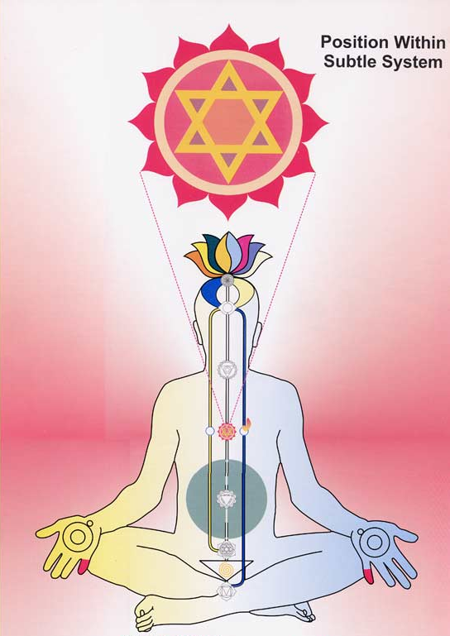
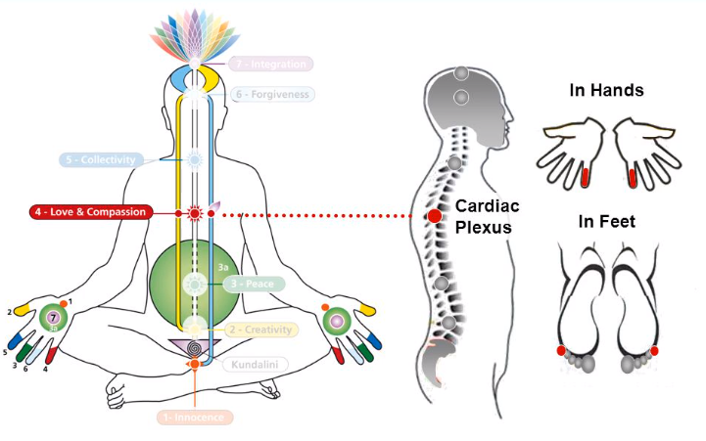
Anahata (Heart) Chakra

Slide 36
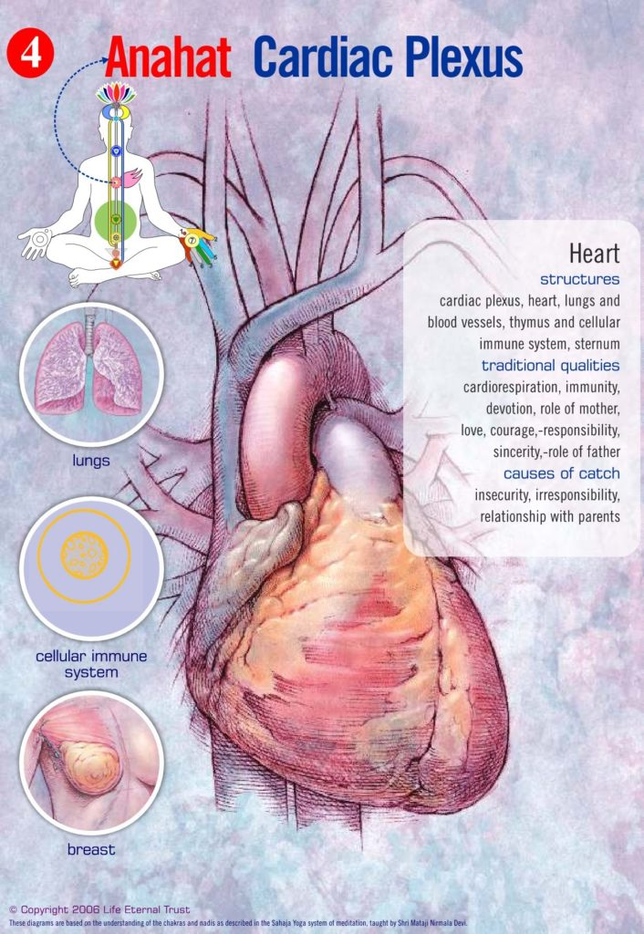
The Heart Chakra - Cardiac Plexus
Element : Air
Physical Aspect : Looks after heart & lungs
Qualities : Creation/ formation of the T-cells of the immune system, compassion, pure love, complete sense of security, confidence, auspicious boundaries (Maryadas), joy of the spirit
Causes of Imbalance : Insecurity, motherhood/ fatherhood problems, fear, Hatha Yoga, atheism, no seeking, inconsiderate behaviour.
Diseases : Asthma, heart problems.
On the physical level the Heart Chakra (also called Anahata Chakra) controls our breathing, the action of the heart and the circulation of blood. This chakra is placed behind the sternum in the spinal cord.

Slide 37
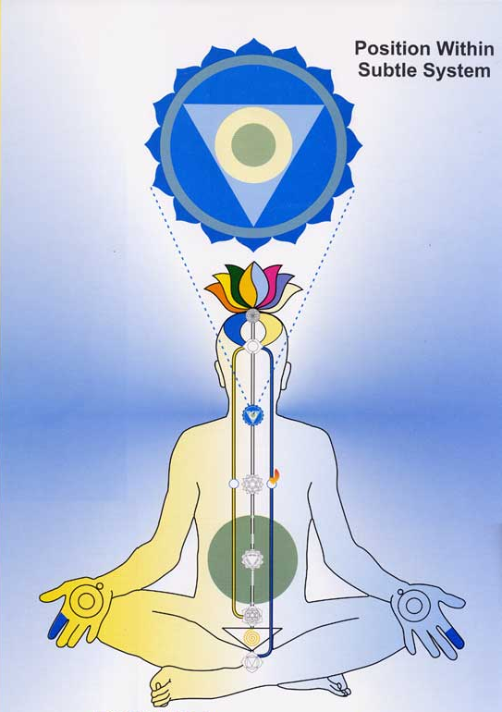
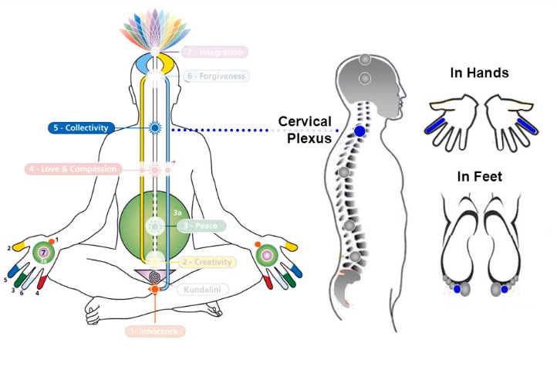
Vishuddhi Chakra

Slide 38
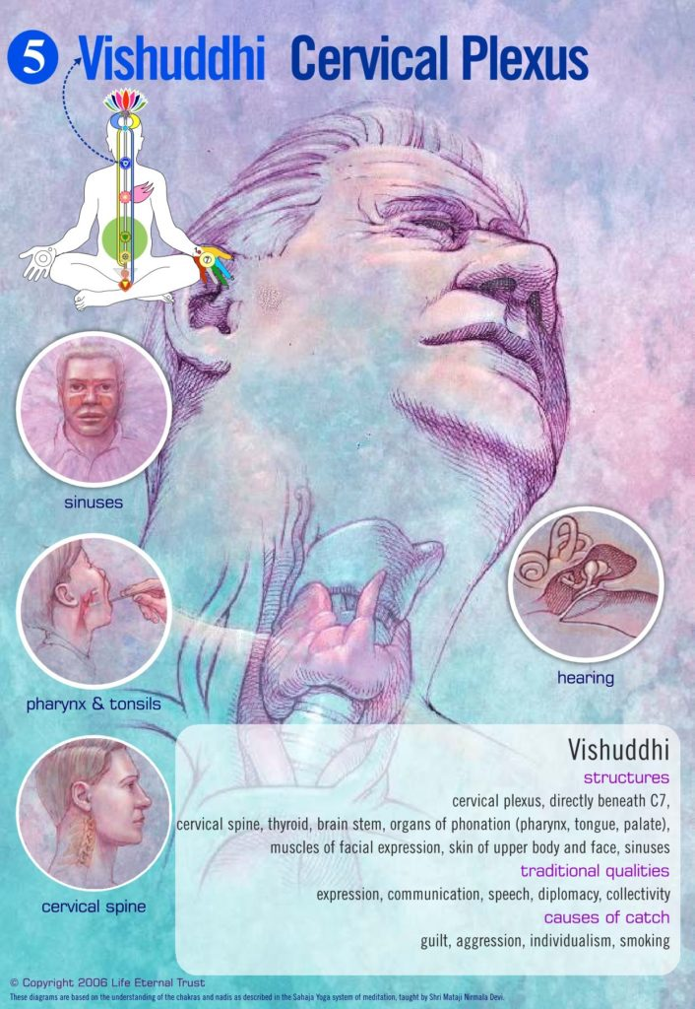
The Vishuddhi Chakra - Cervical Plexus
Element : Ether
Qualities : Divine diplomacy, detachment, witness state, collective consciousness, self esteem, pure relationships, connection with the whole, Madhurya (sweetness)
Physical Aspect :Throat, neck, mouth, teeth, face, nose, tongue, ears and ankles.
Causes of Imbalance : Guilty feelings, feelings of superiority/inferiority, sarcasm, criticism, lack of witnessing .
Situated at the level of the throat, this center controls all our articulation and our communication, the movement of our hands and arms, our facial expression and our speech, as well as the senses of taste and smell. On the physical level it caters for the Cervical Plexus.

Slide 39
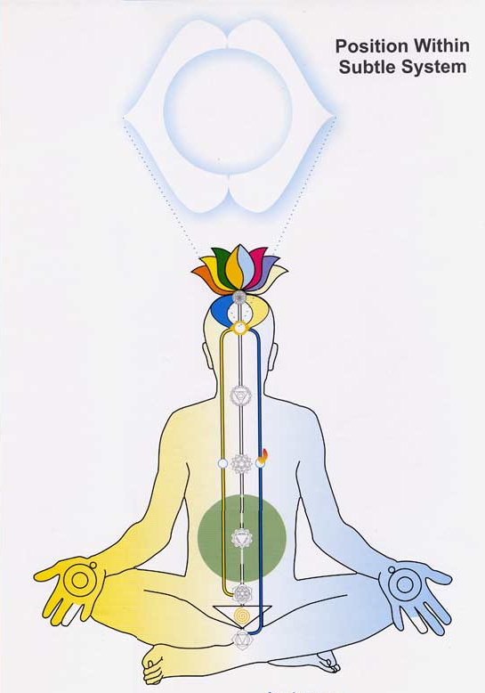
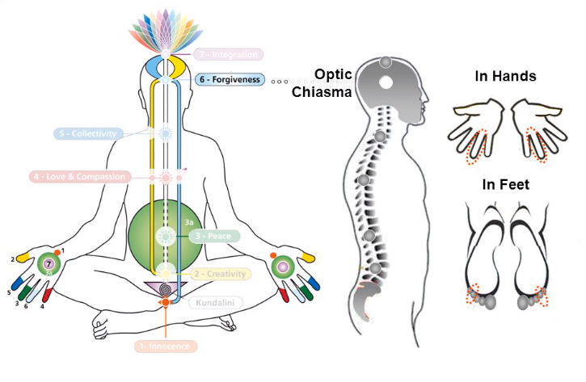
Agnya Chakra

Slide 40
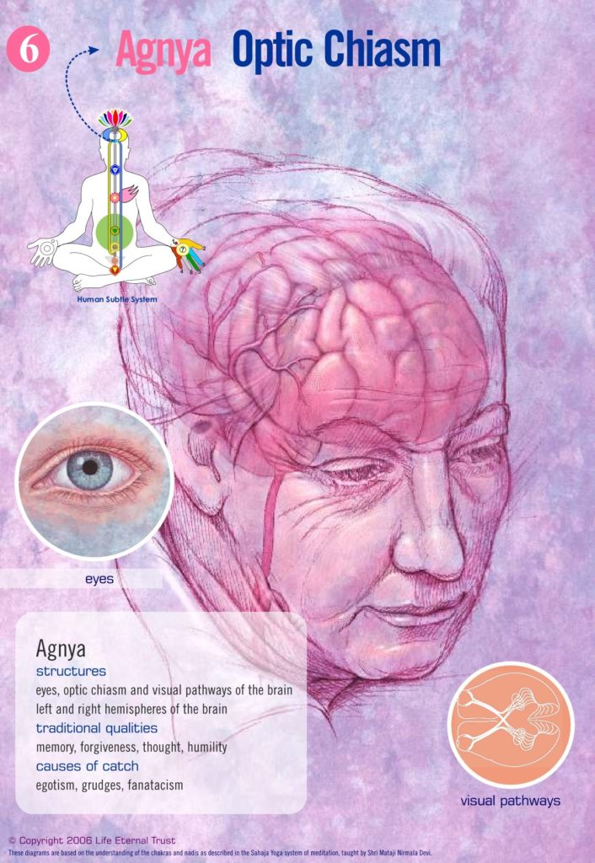
a
The Agnya Chakra - (Optic Chaisma)
Element : Light
Qualities : Forgiveness, humility; dissolves ego, conditionings, false ideas and misidentifications
Physical Aspect : Pineal and pituitary glands.
Causes of Imbalance : Roving eyes, self-centeredness, hatred, lack of forgiveness, harm to self/ others , self pity, inability to forgive oneself, aggression, egoism, futurism.
The Agnya Chakra sits behind the forehead, at the base of the brain, which it controls. When the Kundalini passes the Agnya Chakra, our mental activity ceases, silence and enlightenment takes place. This centre caters for Pituitary and Pineal body.

Slide 41
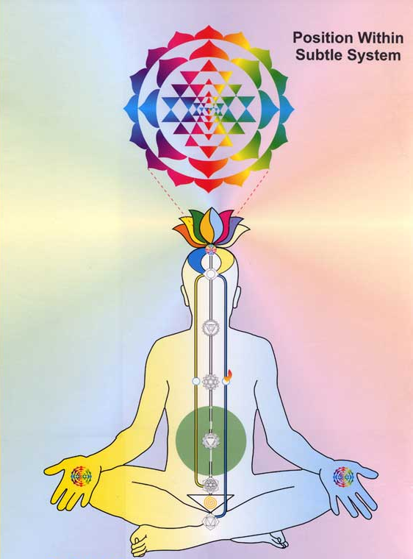
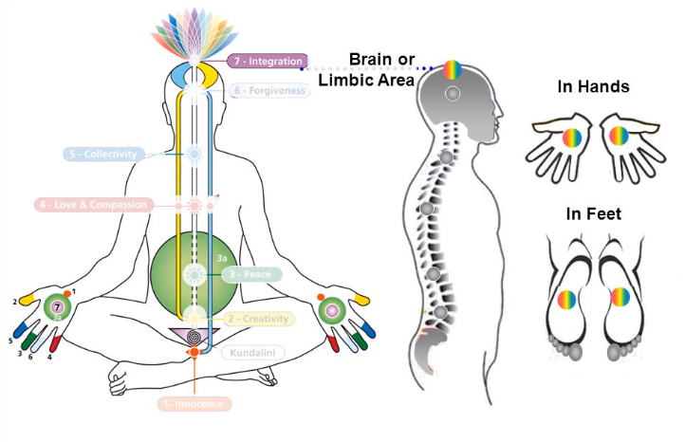
Sahasrara Chakra

Slide 42
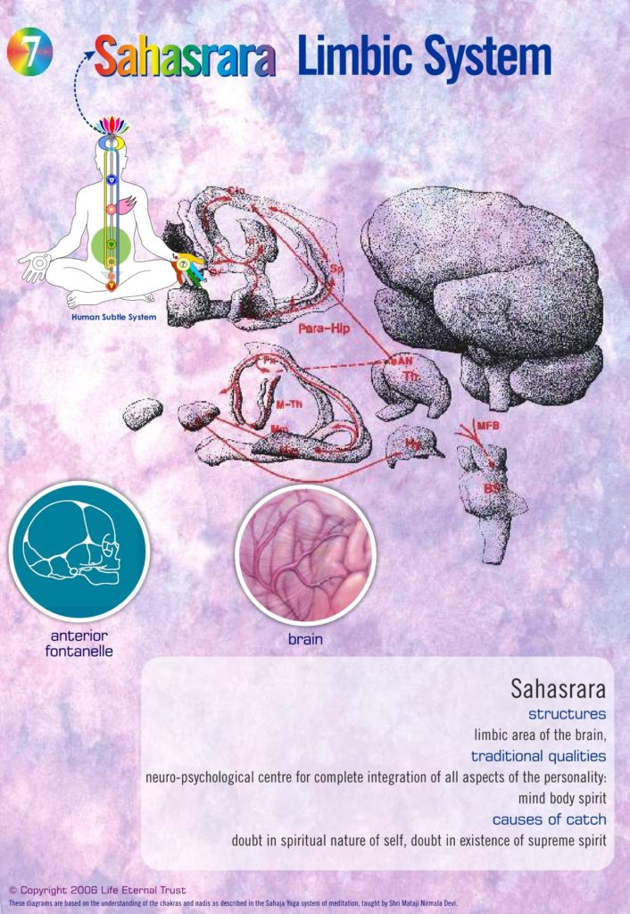
The Sahasrara Chakra (Limbic Area)
1000 petalled lotus.
Physical aspect : Limbic area of the brain
Qualities : Integrates all the Chakras, absolute perception of Reality on our Central Nervous system, thoughtless awareness, Niranand
Causes of Imbalance : Doubt in God, Atheism, anti-God activity
The Sahasrara Chakra is the lotus of a thousand petals whose physical expression is the thousand nerves distributed under the surface of the skull. It is the integration of all the lower Chakras and their powers. Here takes place the integration and synthesis of all the worlds' religions. It is our spiritual destination.
The Sahasrara is the tabernacle of the higher synthesis between our consciousness and divinity. To express the glory of this dimension, words (as do thoughts) fail.

Slide 43

THE AGE OF SUPER-SPECIALITY
Extract from: Medical Science Enlightened
Professor Umesh C Rai M.D.
New insight into Vibratory Awareness for Holistic Health Care
The doctors of today practising Western medicine have entered into the age of super-speciality to a point where separate parts of the body are being treated by different specialists .
For example,
Heart is treated by Cardiologist,
Brain by Neurologist,
Stomach and Intestines by Gastroenterologist,
Blood by Hematologist,
Kidney by Nephrologist,
Urinary bladder by urologist,
Skin by Dermatologist and so on.

Slide 44
This approach of western medicine has gone to a stage where doctors are no longer able to view disease as a disturbance of the whole organism: The net result of such an approach is that they treat a particular part of-the body without taking into consideration the rest of the body.
They hardly look into the psychological, social and environmental aspects of the patients illness which are so very important.
As a result of this there is nothing much with the western system of Medicine to look after the Psychic aspect of human beings except to use tranquilizers and sedatives to control this aspect.
Increasing use of tranquilizers and sedatives in medical practice is not only harmful but also habit-forming.
It also illustrates the extent to which the stress and strain of modern life has permeated our society.
The use of tranquilizers for Iong-term are habit-forming and on withdrawal, produce symptoms like lack of energy, impaired memory, sleep disturbances, agitation, restlessness; irritability, tremors, muscle pain, aches, twitching, loss of appetite, nausea and depression.

Slide 45


Slide 46
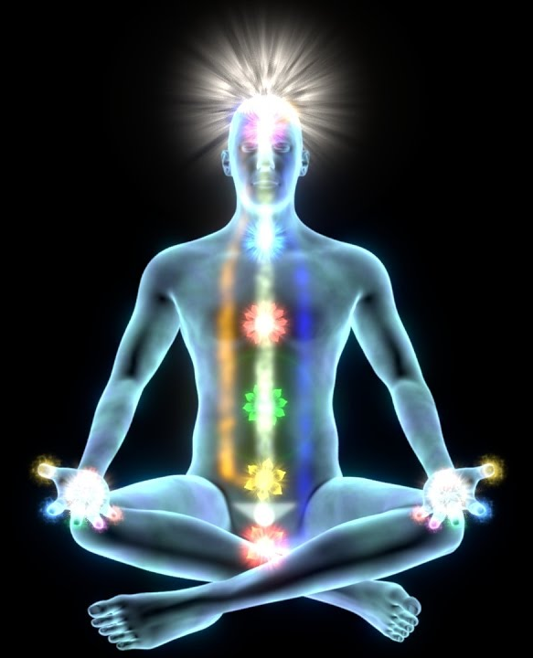
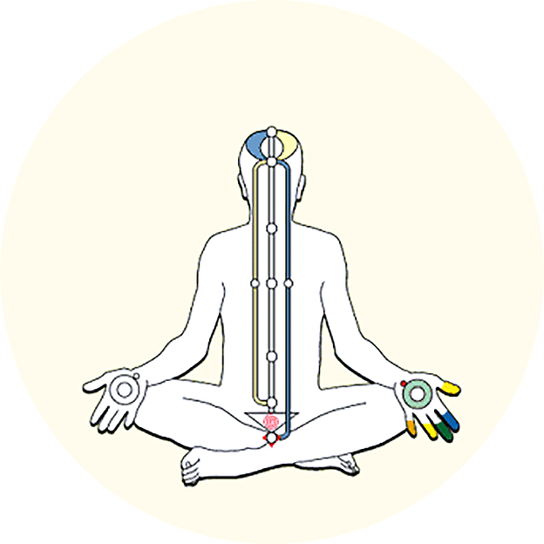
Holistic health integrates the physical, mental, emotional and spiritual health of an individual.
WHO statics reveal stress will be the number one killer in the 21st century. We know that the mind generates stress, but we cannot control the mind with the mind. To control our mind whatever we do is done by the mind. It explains why all therapies by whatever name they are called have failed or are temporary.
However, in 1970 H.H. Shri Mataji Nirmala Devi discovered a unique method called Sahaja Yoga that works beyond the mind. By Sahaja Yoga a person is given self- realization. That is, it activates a germinating force within us called the kundalini. The kundalini awakens all the powers within us that have to be awakened to bring our physical, mental, emotional health in balance.
Since 1970 hundreds of thousands people globally have experienced its benefits. Moreover, as one person gets his realization he can pass it to the other, or give en mass realization online. No money is charged for this. It has also worked successfully in treating patients with chronic medical problems ( reports attached). In the field of agriculture vibrations are used for awakening the potential in seeds that has led to enhanced production. ( attached reports).

Slide 47



Sahaja Yoga - Medical Research Information
Sahaja Yoga
Meditation
And
Medical Research Information
Meditation is essentially a hypometabolic state with parasympathetic dominance – different from sleep – that elicits physical and mental calm, and has been reported to enhance psychological balance and emotional stability.
www.meditationresearch.co.uk

Slide 48
Meditation and Neuroscience
Mental Silence benefits your brain.
• Meditators showed around 7% more grey matter, the largest published difference between healthy groups.
• As grey matter decreases with age and with most mental illnesses, this difference throughout the brain is associated with a younger and healthier brain.
• The grey matter difference was more marked in areas related to the control of attention and emotions.
It is said that, for more than forty thousand years, human beings have a language that allows us to communicate with precision, that language is reproduced within our brain as thoughts without interruption. When negative thoughts are repeated in vicious cycles, our mental health can be affected with issues such as stress, anxiety or depression.
Today there is plenty of scientific literature that shows that being with the attention in the present moment, in the here and now, is beneficial for our psyche and our general health. Unfortunately, thoughts take us out of the present moment and to stop the thoughts for a long time is not easy, especially when we are not doing tasks that demands much attention.

Slide 49
Yoga includes many different techniques, among which meditation (Dhayana in classical yoga) plays a leading role.
The first yoga treatise, "The Yoga Sutras of Patanjali", mentions that "yoga is the suppression of the modifications of the mind."
In ancient yoga a higher state of consciousness has been described, called “Nirvichara Samadhi”, which can be translated as "mental silence" or "thoughtless awareness". In this state, the mind is calm, with a feeling of inner bliss, and with the attention focused on the present moment.
Sahaja Yoga Meditation puts into practice the goals of classical Yoga to achieve the state of Nirvichara or mental silence.
Researchers led by Professor Sergio Elías Hernández from the University of La Laguna in Tenerife (ULL), in collaboration with scientists from King’s College London University, Jaume I University of Castellón and Sermas of Madrid, have been exploring for more than ten years the benefits of the state of mental silence on the human brain.
The study was carried out at the ULL MRI scanner, where the researchers recorded the brain anatomy of 23 meditator volunteers, experts in Sahaja Yoga meditation, and 23 non-meditating volunteers. Both groups were made up of healthy volunteers and both groups did not differ in age, educational level, ethnicity, proportion of men and women, etc.

Slide 50
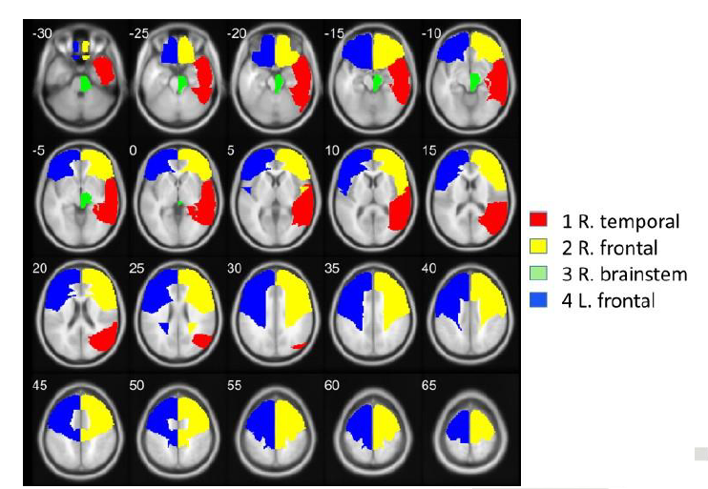
To better understand this study, we must mention that the brain tissue is classified, according to its appearance, into three types:
grey matter, made up of neuronal bodies and interconnections, (dark grey in resonance images);
the white matter, formed by nerve fibers or long connections between distant areas, (light grey in the resonance images),
the cerebrospinal fluid or watery substance that fills the interior voids and serves as protection and transport of chemical substances.
Figure. Brain lobes areas with significant different in grey matter between groups, in the order of 1 to 4, following statistical significance.
The study of brain anatomy showed that meditators had, on average, 7% more grey matter in the whole brain. This type of comparison of the grey matter of the brain has been made in recent years among other groups in: athletes, musicians, taxi drivers, Buddhists, mindfulness meditators, etc. In these cases, the analyses showed that the group studied had local differences, greater grey matter, in brain areas associated with their specific practice, but the difference was never in the whole brain as it is the case with mental silence.

Slide 51

The difference of 7% larger grey matter is especially significant if one takes into account that our brain loses between 0.15% and 0.3% of grey matter per year and small differences in grey matter can mark whether or not we keep intact our cognitive functions. It should be also noted that diseases, typical of the elderly, such as Alzheimer's, senile dementia or Parkinson's are also associated with loss of grey matter.
In conclusion, the study findings show that mental silence, experienced through Sahaja Yoga meditation, is associated with a protective effect on the entire brain, by leading to larger overall grey matter that could potentially reflect a slowing down of age-related loss of grey matter.
The areas where these differences were most noticeable were those that are crucial for the control of attention and emotions.
Since grey matter diminishes with age and with many mental illnesses, this difference throughout the whole brain could suggest a younger and healthier brain for those practising mental silence.

Slide 52
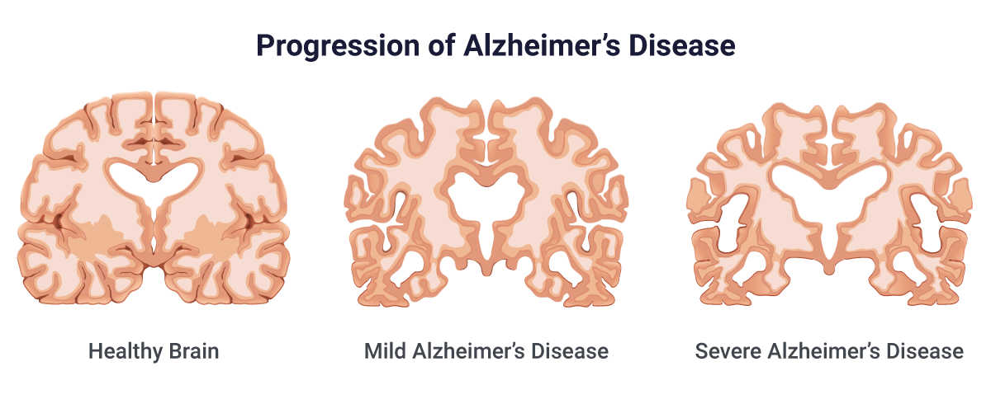
Study authors: Sergio Elías Hernándeza*, Roberto Dortab, José Sueroc, Alfonso Barros-Loscertalesd, José Luis González-Morae, Katya Rubiaf
a: Departamento de Ingeniería Industrial, Universidad de La Laguna, Tenerife, Spain.
b: Departamento de Matemáticas, Estadística e Investigación Operativa, Universidad de La Laguna, Tenerife, Spain.
c: Centro de Salud Jazmín, Sermas, Madrid, Spain.
d: Departamento de Psycología, Universitat Jaume I, Castellón, Spain.
e: Departamento de Fisiología, Universidad de La Laguna, Tenerife, Spain
f: Institute of Psychiatry, Psychology and Neuroscience, King’s College, Londres, UK.

Slide 53
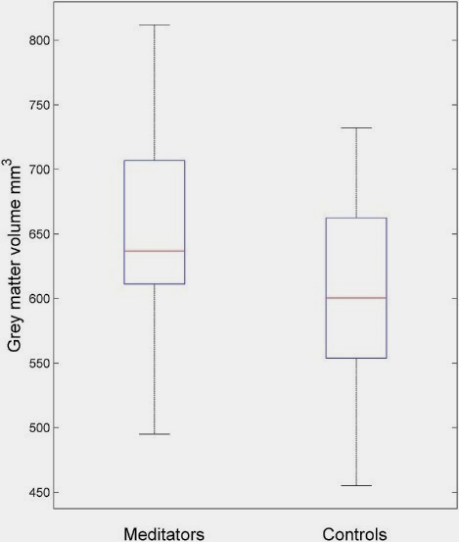
THE STRUCTURE AND THE FUNCTION OF THE BRAIN.
Several neuroimaging studies have shown that Sahaja Yoga Meditation is associated with changes in the structure and the function of the brain.
The structural MRI study of Brain
A structural MRI study conducted at La Laguna University, Spain in collaboration with King’s College London, UK, showed that 23 adult long-term practitioners of SYM who had been meditating between 5 and 28 years compared to 23 healthy volunteers that were matched on age, gender, education level, height, and weight, had overall 7% more grey matter volume (Hernandez et al., 2016).
Meditators had 7% more grey matter than non-Meditators overall. Grey matter typically decreases with age and larger grey matter is associated with better brain functioning.

Slide 54
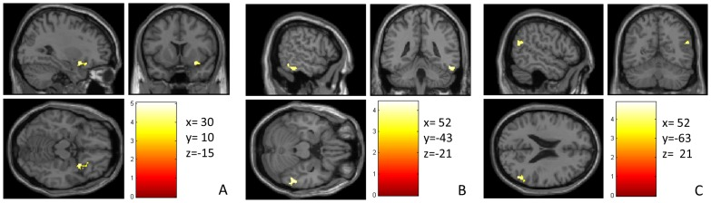
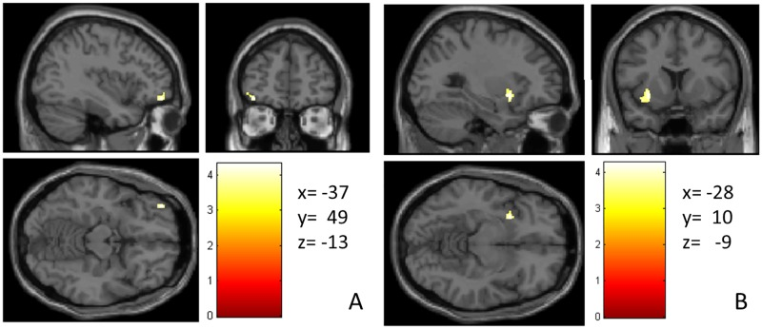
The brain regions that were particularly larger in Meditators were mostly in the right hemisphere and included areas of body self-awareness and emotion control (insula and ventromedial orbitofrontal cortex, respectively), and areas of empathy and social and emotional processes (inferior temporal lobe). Other regions that were enlarged were left inferior frontal cortex and insula which are areas that are crucial for concentration and inhibitory control.
Areas that were larger in Meditators than in non-Meditators:
The right insula/ventromedial frontal cortex (emotion control)
The right inferior temporal lobe (empathy)
The right parietal lobe (attention)
Left inferior frontal lobe (attention; self-control)
Left insula (self-awareness)

Slide 55
The larger volumes in these regions is likely a neuroplastic effect due to the long-term training of enhanced self-awareness, alertness and attention during Meditation practice. Larger structure of the insula has been associated with better emotional intelligence, better self-acceptance and is a predictor of good health.
The ventromedial orbitofrontal cortex is a key region of emotion regulation, in particular of control of negative emotions. Given that meditation is associated with feelings of happiness, greater emotional detachment and a detached witness state, it is likely that the long-term practice of Meditation leads to better control of emotions and in particular of negative emotions.
Grey matter decreases with age due to the normal ageing process.
Larger grey matter overall in Meditators relative to non-Meditators hence suggests that there is a delay in the normal ageing process of grey matter loss due to Meditation. The larger grey matter furthermore is in regions that are typically activated during Meditation such as regions of attention, emotional self-control, bodily self-awareness and feelings of compassion and empathy.
References:
Hernandez, SE, Suero J, Barroso A, Rubia, K (2016) A voxel-based morphometry study on brain structural changes associated with long-term Sahaja Yoga Meditation. PLOS ONE, 11(3):e0150757.
Hernández SE, Barros-Loscertales A, Xiao Y, González-Mora JL, Rubia K. (2018)
Gray Matter and Functional Connectivity in Anterior Cingulate Cortex are Associated with the State of Mental Silence During Sahaja Yoga Meditation. Neuroscience 371:395-406

Slide 56


Sahaja Yoga Meditation and Neurochemistry
There is evidence that meditation experiences are related to limbic brain activation. Several studies have shown changes in neurochemicals that are released by limbic brain regions and mediate positive emotions.
A study conducted by Prof Ram Mishra at the McMaster's University, in Toronto (Mishra et al., 1993), showed that Sahaja Yoga Meditation compared to rest elicited a significant increase of 70% in beta-endorphins as measured in the blood in males.
Beta-endorphins are neuro-hormones, endogenous opioids that are released from the pituitary gland in the hypothalamus and have been associated to feelings of positive affect such as happiness and euphoria.
They are also released during high performance sports and when people are in love. They are thought to play an important role in homeostatic mechanisms, pain reduction and may even affect the immune system.
A strengthening of the immune system through meditation could explain why some people improve in severe illnesses such as cancer with Meditation.
Brain Chemicals that make you happy

Slide 57


Sahaja Yoga Meditation On Skin Temperature Reduction
A study conducted in Australia by Dr Manocha and colleagues (Manocha et al., 2000) showed that long-term Meditators compared to a group of subjects who practiced simple Relaxation showed a reduction in the temperature of their hands during the Meditation.
This correlates with the subjective feelings of coolness in the hands and on top of the brain that is experienced by SY Meditators and has been related to an activation of the parasympathetic-limbic pathway.
Reference
Rai, U.C., Seti, S., Singh, S.H., 1988. Some effects of Sahaja Yoga and its role in the prevention of stress disorders. Journal of International Medical Sciences, 19-23.

Slide 58

Sahaja Yoga - Medical Research Information
Brain Effects
Electrophysiological studies:
The electroencephalogram (EEG) measures the electrical activity from groups of neurons on the surface of the scalp. EEG studies comparing the brain activation of long-term Sahaja Yoga practitioners to short-term Sahaja Yoga meditators found specific brain activation patterns corresponding to the subjective feelings of thoughtless awareness and happiness experienced by the meditators (Aftanas and Golocheikine 2000, 2001, 2002).
In their EEG measures, the long-term meditators showed increased power in low band frequency EEG activity of theta and alpha, which was particularly pronounced over the left frontal region.

Slide 59


Sahaja Yoga - Medical Research Information
Brain Activation Correlating With Thoughtless Awareness And Happiness
During Meditation, long-term meditators showed less mental activity, i.e. less thoughts (IV) and more feelings of happiness (VI) according to their subjective ratings.
The intensity of the feelings of happiness was positively correlated with the theta activity over left frontal regions. This is in line with the evidence for a role of the left frontal lobe in positive emotions whereas the right prefrontal lobe plays a greater role in negative ones.

Slide 60



Sahaja Yoga - Medical Research Information
There was also increased activation in the alpha power range over the same regions, which is thought to reflect a reduction in brain regions that mediate mental effort and external attention. Increased activation in alpha activity has commonly been observed in Meditators of different traditions and been found to correlate with reduced levels of anxiety.
In addition to enhanced fronto-parietal theta activation, the authors also found enhanced connectivity of fronto-parietal theta bands – suggesting the enforcement of attentional networks.
A reduction in the chaotic dimensional complexity was also observed suggestive of the inhibition of task-irrelevant processes.

Slide 61
Sahaja Yoga - Medical Research Information
Taken together, the findings suggest that during Sahaja Yoga Meditation, the reduced mental activity is mediated by increased activation of networks of internalised attention which seem to trigger activity in regions that mediate positive emotions (left frontal cortex) while decreasing networks related to external attention and irrelevant processes.
The enhanced connection between frontal and parietal regions is probably a prerequisite for the general intensification of internalised attention necessary for the induction of the altered state of mental silence.
In conclusion, this ground-breaking study shows that the subjective experiences of mental silence and positive emotions during Meditation have very specific neurophysiological correlates in the activation and connectivity of regions that mediate internalised attention and positive affect.
References
Aftanas LI, Golocheikine SA. (2001): Human anterior and frontal midline theta and lower alpha reflect emotionally positive state and internalized attention: high-resolution EEG investigation of meditation. Neuroscience Letters 310(1):57-60.
Aftanas LI, Golocheikine SA. (2002): Non-linear dynamic complexity of the human EEG during meditation. Neuroscience Letters 330: 143-146.
Aftanas LI, Golosheikin S.A. (2003): Changes in cortical activity in altered states of consciousness: the study of meditation by high-resolution EEG. Human Physiology 29(2):143-151

Slide 62


Sahaja Yoga - Medical Research Information
Effects of Sahaja Yoga Meditation on ADHD
A study conducted in Australia, at the Natural Therapies Research Unit of the Royal Hospital for Women in Sydney, and in collaboration with the Institute of Psychiatry, King’s College London, UK, showed significant improvement of the symptoms of Attention Deficit Hyperactivity Disorder (ADHD).
ADHD is a disorder that develops in childhood and is characterised by problems of attention, impulsiveness and hyperactivity.
The treatment of choice in ADHD is the administration of stimulant Medication. However, there are side effects, there is concern about the unknown long-term effects of stimulants on brain development and there is evidence that the benefits of medication are much reduced after about a year of use.
For these reasons parents prefer non-pharmacological treatment and there is a search for effective non-pharmacological treatment options.

Slide 63

Sahaja Yoga - Medical Research Information
26 children with ADHD, aged between 4 and 12, were treated for 6 weeks with Sahaja Yoga Meditation adjunctive to their usual treatment (i.e. some of them were receiving stimulant medication) and then compared to a waiting list control group who received no treatment.
Children with ADHD who learned how to meditate compared to the waiting list control group showed a significant reduction of the main symptoms of hyperactivity, impulsiveness and inattention. Other, secondary benefits were an improved child-parent relationship and enhanced self-esteem in the children.
This reduction of symptoms was observed equally in medicated and non-medicated patients.
Furthermore, of the children who were treated with stimulant medication, over 50% either discontinued or reduced their stimulant medication but still improved in their symptoms.

Slide 64

Sahaja Yoga - Medical Research Information
The children improved in their behaviour at home and at school.
This pioneering study suggests that Meditation is a promising non-pharmacological treatment option for children with ADHD that needs to be further explored.
Reference:
Harrison, L., Rubia, K., Manocha, R. (2003) Sahaja Yoga Meditation as a Family Treatment Program for Attention Deficit Hyperactivity Disorder Children. Clinical Child Psychology and Psychiatry, 9 (4), 479-497.

Slide 65
ADHD: Subjective Ratings
Sahaja Yoga - Medical Research Information
Parents’ ratings of child’s benefits from Meditation at home
BENEFITS OF MEDITATION ON BEHAVIOR AT SCHOOL
BENEFITS OF MEDITATION FOR PARENTS

Slide 66


Sahaja Yoga - Medical Research Information
Effects of Sahaja Yoga on Drug Abuse
A study conducted at the University of Vienna by Dr W Hackl showed highly significant effects of Sahaja Yoga Meditation on drug consumption. The study used a retrospective questionnaire in 501 Meditators of Sahaja Yoga of which 268 people had used drugs before starting with the meditative practice.
The retrospective questionnaire showed that 97% of chronic drug consumers stopped taking drugs, most of them at the beginning of the Meditation practice, i.e. 42% after the first week of meditation, 32% after the first months (Hackl, 1995).
A reduction of drug consumption was observed both for heavy and light users:
a) Light Users
b) Heavy Users

Slide 67

Sahaja Yoga - Medical Research Information
The study thus shows a significant and lasting effect of Sahaja Yoga Meditation on drug consumption and drug abuse.
References
Hackl, W. The effect of Sahaja Yoga on drug consumption. Die Auswirkungen von Sahaja Yoga auf das Drogenkonsumverhalten. Doctoral thesis submitted to the University in Vienna, 1995

Slide 68

Sahaja Yoga - Medical Research Information
Effects of Sahaja Yoga Meditation on Epilepsy
One of the most consistent findings in the meditation literature is the effectiveness of Sahaja Yoga meditation in epilepsy.
A series of studies have shown significant reductions of the number of seizures in patients with epilepsy of up to 86% after 6 months of treatment with Sahaja Yoga meditation compared to sham meditation.
Sahaja Yoga elicited a reduction in seizures of 65% after 3 months and of 86% after 6 months. The sham meditation condition or non-treatment lead to no significant changes over 6 months. In addition, there was also a reduction of stress-related physiological indicators only in those patients treated with Sahaja Yoga meditation.

Slide 69

Sahaja Yoga - Medical Research Information
Sahaja Yoga elicited a reduction in seizures of 65% after 3 months and of 86% after 6 months. The sham meditation condition or non-treatment lead to no significant changes over 6 months. In addition, there was also a reduction of stress-related physiological indicators only in those patients treated with Sahaja Yoga meditation.
An increase in skin resistance indicating decreased sympathetic activity (more relaxation).
An reduction in in blood lactate indicating less anxiety.
An reduction in vanillil mandelic acid (VMA), indicating reduced stress levels.
The authors argue that the reduction in stress following Sahaja Yoga practice may be responsible for the clinical improvement observed.
References:
Gupta H, Dudani U, Singh SH, Surange SG, Selvamurthy W. (1991): Sahaja Yoga in the management of intractable epileptics. Journal of Association of Physicians of India 39(8):649.
Panjwani U, Gupta H, Singh SH, Selvamurthy W, Rai UC. (1995): Effect of Sahaja Yoga practice on stress management in patients of epilepsy. Indian Journal of Physiology and Pharmacology 39:111-116.
Panjwani U, Selvamurthy W, Singh SH, Gupta HL, Mukhopadhyay S, Thakur L. (2000): Effect of Sahaja yoga meditation on Auditory Evoked Potentials (AEP) and Visual Contrast Sensitivity (VCS) in epileptics. Applied Psychophysiology and Biofeedback 25(1):1-12.
Panjwani U, Selvamurthy W, Singh SH, Gupta HL, Thakur L, Rai UC. (1996): Effect of Sahaja yoga practice on seizure control and EEG changes in patients of epilepsy. Indian Journal of Medical Research 103:165-172.
Yardi N. (2001): Yoga for control of epilepsy. Seizure-European Journal of Epilepsy 10(1):7-12.

Slide 70
Epilepsy
Sahaja Yoga - Medical Research Information
Sahaja Yoga and sham intervention on patients with epilepsy for 6 months
Reduction of EEG epileptiform spikes; increase in alpha and delta EEG activity
Reduction in stress-related physiological measures (> parasympathetic activity)
Seizure reduction:
65% after 3 months
86% after 6 months
Panjwani et al., 1995, 1996
Gupta et al., 1997

Slide 71


Sahaja Yoga - Medical Research Information
Effects of Sahaja Yoga Meditation on Asthma
Given the effects of meditation on reducing sympathetic activity and respiratory rates, several studies have investigated whether meditation would have an effect on respiratory diseases.
A study conducted at the Natural Therapies Unit of the Royal Hospital for women, in Sydney, Australia, showed a significant beneficial effect of Sahaja Yoga on Asthma patients who were resistant to steroids (Manocha et al., 2000).
47 patients with severe asthma were randomly allocated to two groups: one group received Sahaja Yoga Meditation treatment (21 patients), the other group received general relaxation treatment (26 patients), both conducted over 4 months and involving a 2 hour session.
The Sahaja Yoga Meditation group showed a significant reduction in the severity of asthma as measured in airway hyper-responsivity in response to chemical challenge (an objective indicator of the severity of asthma) compared to the control group who received relaxation.
Similar findings were observed previously in a smaller trial using the same meditation technique (Chugh et al., 1997).
References
Chugh D. (1997): The effects of Sahaja Yoga in bronchial asthma and essential hypertension. New Delhi Medicos 13(5):46-47.
Manocha R, Marks GB, Kennhington P, Peters D, Salome CM. (2002): Sahaia yoga in the management of moderate to severe asthma: a randomised controlled trial. Thorax 57(2):110-115.
In addition there was an increase in the subjective ratings of mood.

Slide 72

Sahaja Yoga - Medical Research Information
Effects Of Sahaja Yoga Meditation On Menopausal Symptoms
A study conducted at the Sydney Menopause Centre, Royal Hospital for Women, Australia, showed that Sahaja Yoga meditation is effective as a treatment for menopausal symptoms. Sahaja Yoga meditation was taught for 8 weeks, twice-weekly, in 10 women with menopausal symptoms instead of the more traditional treatment of hormone replacement therapy for the management of menopausal hot flushes.
The average improvement after Sahaja Yoga meditation training was similar to that expected from hormone replacement therapy and similar or better than that of other behavioural treatments such as cognitive behavioural therapy (CBT). Improvements were observed in the frequency of hot flushes, which were reduced to 67% below the baseline frequency rate. At follow up, it was still 57% below baseline (a reduction in hot flushes frequency of 50% is considered an improvement).
Meditation is an attractive option for women with menopausal symptoms because they prefer non-pharmacological treatments, thereby avoiding the risks and side effects of hormone replacement therapy.
Significant improvements also occurred in a Climacteric Scale, the Menopause Quality of Life Questionnaire, and both State and Trait Anxiety subscales.
References
Manocha, M, Semmar B (2007) A Preliminary Study of Efficacy and Safety of Sahaja Yoga Meditation as a Treatment for Hot Flushes and Other Symptoms of the Perimenopause. Journal of Clinical Psychology in Medical Settings, 14, 266-273.

Slide 73

Sahaja Yoga - Medical Research Information
Effects Of Sahaja Yoga Meditation On Personality
A study published in the International Journal of Neuroscience compared 25 meditators of Sahaja Yoga to a group of 25 comparison subjects who did not practice meditation on a range of trait personality measures. The long-term meditators scored significantly lower in personality features of anxiety, neuroticism, psychoticism, and depression and scored higher in emotion recognition and expression.
This suggests that long-term meditation practice leads to higher psycho-emotional stability and better emotional skills.
References
Aftanas L, Golosheykin S. (2005): Impact of regular meditation practice on EEG activity at rest and during evoked negative emotions. International Journal of Neuroscience 115(6):893-909.

Slide 74


Sahaja Yoga - Medical Research Information
Effects of Sahaja Yoga on State and Trait Anxiety
A study conducted at the University of Vienna found a significant beneficial effect of Sahaja Yoga Meditation on state and trait anxiety in healthy adults.
A group of 37 adults was taught Sahaja Yoga Meditation for 8 weeks and compared to a group of 32 adults who received no intervention and a group of 32 adults who had to listen to music of Mozart.
The group who received Meditation showed a significant reduction in their levels of state and of trait anxiety compared to both controls and to the group that listened to Mozart.
References
Hackl, W. (1995) Die Auswirkungen von Sahaja Yoga auf das Drogenkonsumverhalten (The effect of Sahaja Yoga on drug consumption). Doctoral thesis submitted to the University in Vienna, 1995.
a) State anxiety
b) Trait anxiety

Slide 75

Sahaja Yoga - Medical Research Information
Effects of Sahaja Yoga Meditation on Depression
A study conducted at the University of Exeter, UK, showed that Sahaja Yoga Meditation has a beneficial therapeutic effect on the symptoms of patients with depression and anxiety.
Patients with depression & anxiety were divided into three groups: a group receiving Sahaja Yoga Meditation over 6 weeks, a group receiving the conventional behavioural treatment for depression, i.e. cognitive behavioural therapy and a control group that received no treatment.
The group treated with Sahaja Yoga Meditation compared to the non-treated group showed a statistically significant reduction in the symptoms of anxiety, depression and general mental health. At a trend level the Sahaja Yoga Meditation group also showed improvements compared to the group treated with CBT.
The study shows that Sahaja Yoga Meditation has a significant effect on improving the symptoms of anxiety and depression, which was more pronounced than the conventional behavioural treatment for the disorder.
Reference
Morgan A. (2001): Sahaja Yoga: An ancient path to modern mental health? Transpersonal Psychology. Transpersonal Psychology Review 4:41-49.

Slide 76

Conclusions
Sahaja Yoga Meditation (SYM) - Medical Research Information
Sahaja Yoga Meditation activates the parasympathetic nervous system: stress reduction
Decrease in heart rate
Decrease in breathing rate
Decrease in pulse rate
Decrease in blood pressure
Decrease in oxygen metabolism
Decrease in other physiological parameters of
stress
(vanillic mandelic acid, blood lactic acid => anxiety)
The state of mental silence reduces sympathetic activity
=> de-stresses the body
Rai et al., 1995, 1996, Manocha et al., 2010

Slide 77
Conclusions
Sahaja Yoga - Medical Research Information
SAHAJA YOGA MEDITATION (SYM) - effects on work stress
  80% feel stressed at work (US Institute of Stress)
  40% need professional help (mild backpain to severe depression)
  The costs to society are enormous (UK Health & Safety Executive 2002 £370 mill).
8 weeks of SYM elicits greater improvement in work stress & depressive scores than relaxation response or no treatment
Manocha et al., Evidence-based Complimentary & Alternative Medicine, 2011

Slide 78
Conclusions
Sahaja Yoga - Medical Research Information
Effects of Sahaja Yoga Meditation on Depression
Study design: 24 patients with depression, 27-53 yrs.
3 groups: Sahaja Yoga Meditation, CBT, Control (no treatment). 6 weeks.
Anxiety (HAM-D)
General Mental Health
Depression
Morgan et al., J Consciousness, 2000

Slide 79

Conclusions
Sahaja Yoga - Medical Research Information
Meditation can be an effective form of stress reduction and has the potential to improve quality of life and decrease healthcare costs.
Although meditation differs from relaxation techniques, the components which constitute this difference have not yet been clearly defined.
Meditation involves achieving a state of ‘thoughtless awareness’ in which the excessive stress producing activity of the
mind is neutralised without reducing alertness and effectiveness.
Authentic meditation enables one to focus on the present moment rather than dwell on the unchangeable past or undetermined future.
There is little quality evidence comparing one meditation technique with another or meditation with relaxation techniques.
The theoretical explanation for the effects of meditation and relaxation techniques is that the release of catecholamines and other stress hormones are reduced and parasympathetic activity is increased.
Whether meditation involves other unique neurophysiological effects remains to be proven.
Medical Science Conclusions by:
Dr Ramesh Manocha
Natural Therapies Unit
Royal Hospital for Women
Locked Bag 2000
Randwick, NSW 2031
Email: R.Manocha@unsw.edu.au

Slide 80


Conclusions
Sahaja Yoga - Medical Research Information
  Enhances the parasympathetic nervous system
  => restoration of bodily functions
  Mental Silence is a different state of consciousness
    activation of areas of attention &
    the limbic system (joy) &
    “happy” mood-stabilizing brain chemicals
  “Sat-Chitta-Ananda”: to be pure Attention & Joy
  The state of mental silence is associated with better health => illness prevention
  Sahaja Yoga Meditation has a positive effect on a wide range of diseases => disease therapy
    Mental illness: Depression/Anxiety, Work Stress, Drug abuse, ADHD
    Physical illness: Epilepsy, Asthma, Menopause, Diabetes
  The benefits are associated with the state of mental silence & are superior compared to other meditation techniques that do not lead to the state of mental silence

